Slide 1
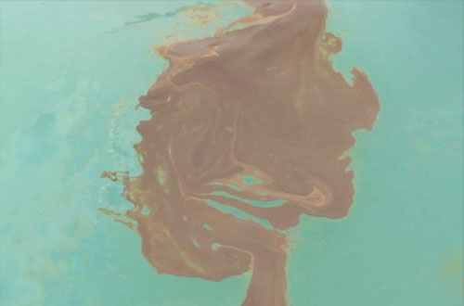
What impact do humans have on marine environments?
Photo Credit: Common Good Productions

Slide 2
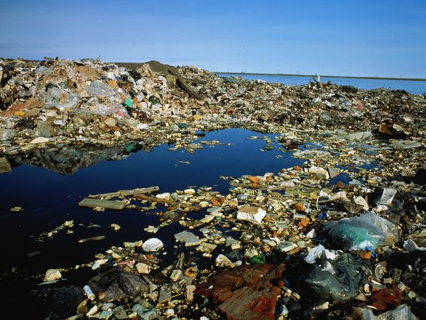
What impact do humans have on marine environments?
Photo Credit Ken Graham/Getty Images
Notes:
An open-air garbage dump tarnishes the sapphire coast of Barrow, Alaska. Trash that makes its way into the oceans decomposes very slowly, littering coastlines, polluting ground water, and harming marine creatures that mistake the trash for food.
http://ocean.nationalgeographic.com/ocean/photos/ocean-pollution/

Slide 3
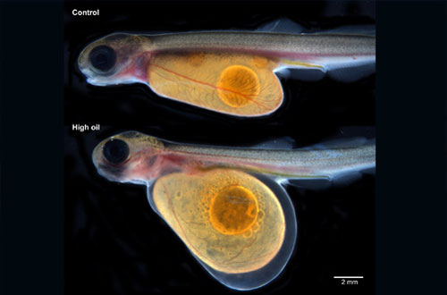
What impact do humans have on marine environments?
Photo Credit: Mark Carls, NOAA

Slide 4
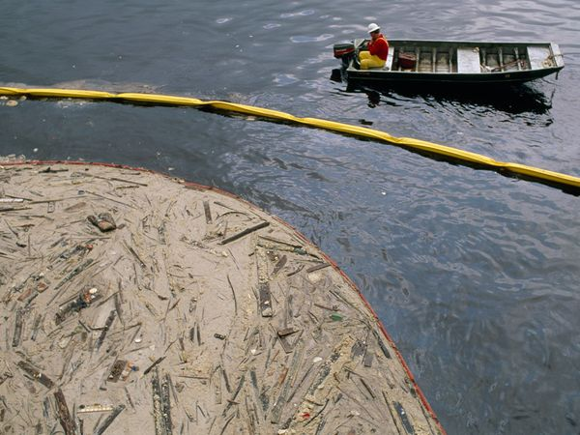
What impact do humans have on marine environments?
Photo Credit Joel Sartore
Notes:
Constant waterborne commerce at the Port of Houston, among the busiest in the United States, means accidents like this tallow spill in the Houston Shipping Channel are inevitable. The world's shipping lanes and ports are epicenters of manmade pollution, where accidental spills and deliberate dumping are commonplace.
http://ocean.nationalgeographic.com/ocean/photos/ocean-pollution/#/pollution11-congealed-tallow-houston_16641_600x450.jpg

Slide 5
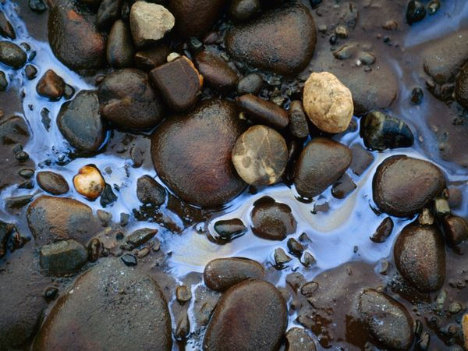
What impact do humans have on marine environments?
Photo Credit Joel Sartore
Notes:
Oil shimmers among rocks on Alaska's North Slope, a region where rich reserves of both wildlife and hydrocarbons have led to pitched battles between environmentalists and petroleum interests. Oil spills wreak havoc on coastal plants and marine animals. But high-profile incidents, such as the 1989 Exxon Valdez accident in Alaska, tend to focus public attention on the issue of ocean pollution. Single-hulled oil tankers were outlawed in the U.S. after that devastating spill
http://ocean.nationalgeographic.com/ocean/photos/ocean-pollution/#/pollution02-oil-slick-alaska_16635_600x450.jpg

Slide 6
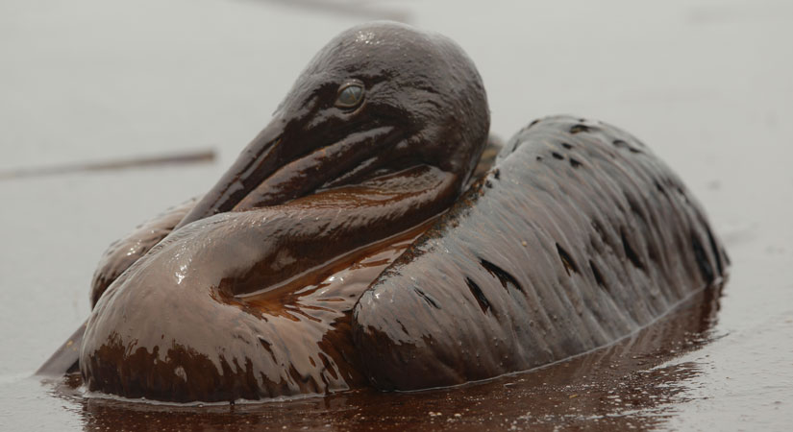
What impact do humans have on marine environments?
Photo Credit AP Photo/Charlie Riedel
Notes:
June 4, 2010 -- Oil spilled from the Deepwater Horizon rig explosion has not only affected the coastlines of several states; it has also devastated the local wildlife throughout the Gulf of Mexico. BP engineers installed a cap over the spewing pipe nearly a mile below the surface late Thursday night, which has helped to stem the flow of oil from the leak.
Here a few of the latest images of birds caught in the oil slick on a East Grand Terre Island beach off the coast of Louisiana:
A heavily-oiled brown pelican sits quietly on the surface of the oil-contaminated water.
http://news.discovery.com/animals/oiled-birds-gulf-oil-spill.html

Slide 7
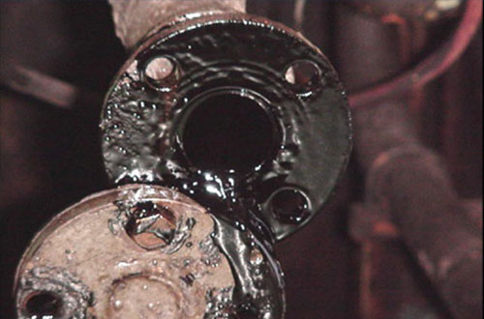
What impact do humans have on marine environments?
Photo Credit: US Department of Justice

Slide 8
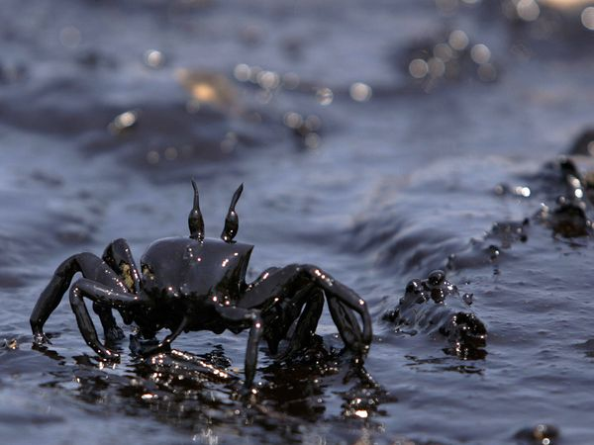
What impact do humans have on marine environments?
Photo Credit Patrick Baz/AFP/Getty Images
Notes:
With the area's preponderance of fossil fuel-related commerce, the semi-enclosed Mediterranean Sea is particularly susceptible to oil spills. International animosities in the region aggravate the problem. This crab is negotiating an oil-fouled beach polluted when Israeli planes bombed a power station in Beirut, Lebanon, in 2006.
http://ocean.nationalgeographic.com/ocean/photos/ocean-pollution/#/pollution12-oil-covered-crab_16642_600x450.jpg

